Slide 1

AUTOMOBILE
E-Store!

Slide 2


Group Members!
Salman Ali
Zaid-ul-haq
Fa16-bcs-318
FA16-BCS-330
Supervisor
Sir. Imran Latif
(Assistant Professor)

Slide 3
Idea of Automobile E-Store
E-store online platform like (sehgalmotors.com, Pak Wheels.com). This platform is for
Supplier
Customer
Parts
Mechanics
Local Shopkeeper

Slide 4
Introduction:
Automobile E-Store.
To connect people with E-store.
For those who don’t have online business.
Third party application(Mediator).

Slide 5
Objectives
Facility of Products and Services.
Saving time from visiting individual stores.
Support ventures in advertisement.
Provides customization of individual store/site.
A one-stop shop for individual business.

Slide 6
Problem Statement
No one-stop platform for E-store.
Most automobile companies don’t have online store.
Facing issue of not getting payment on time.
Issue of online sales and promotions.
Customer have to visit many websites.
Time wastage.

Slide 7
Solution
A Hub for all automobile companies.
An online store for every business.
Security assurance of payments.
No more browsing on individual sites.
Time saving.
Customization of theme and looks individually for all.

Slide 8
Similar Projects
https://www.napaonline.com/
https://www.popularmechanics.pk/
https://www.sehgalmotors.pk/
https://www.chaudhryautostore.com/
https://trims.pk/

Slide 9






Implementation
.Net for backend programming.
Database(MYSQL).
Frontend
HTML.
CSS(bootstrap).
jQuery.
JS.
Bootstrap-4

Slide 10
Why we choose Web?
Web is easily convertible for other platforms.
Responsive Design for Android, IOS and other devices.
Huge Community of developers for problem solving.
Much customization accessibility.
Easily accessible.
More number of users than other technologies.

Slide 11
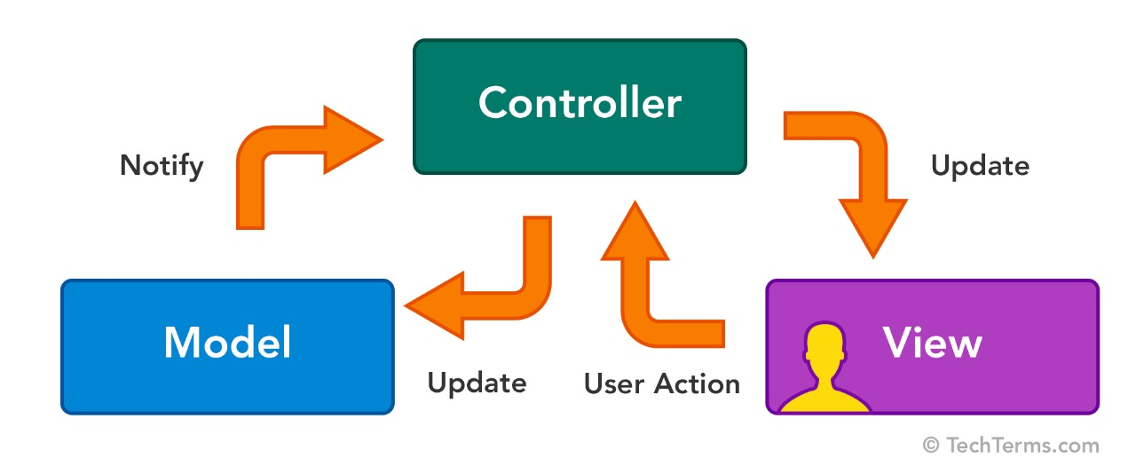
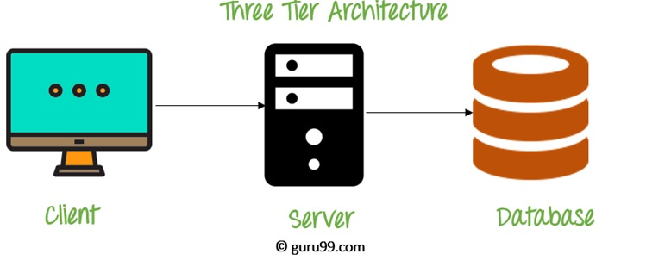
Architecture
MVC
Three tier Application

Slide 12
Modules
Automobile e-store
Admin Panel
Buyer Panel
Supplier Panel

Slide 13
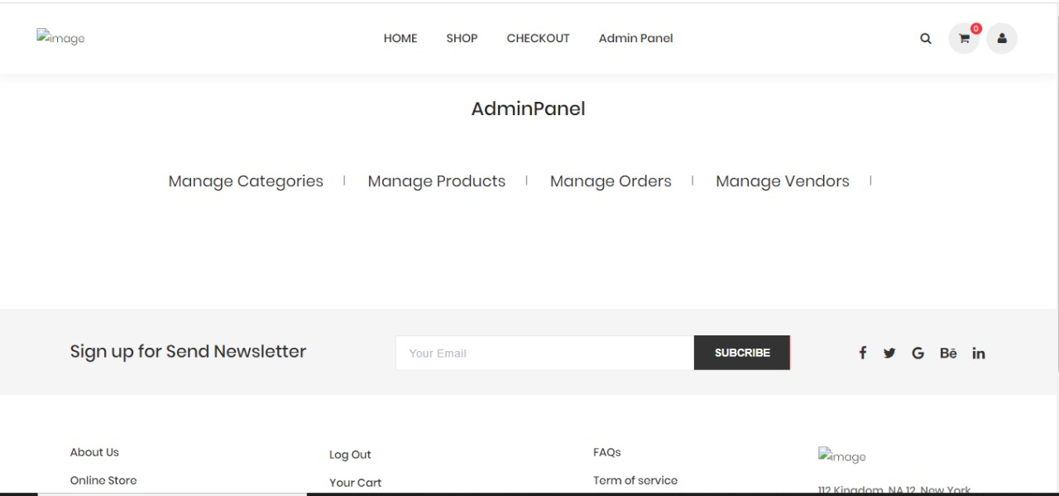
Admin Panel
Overall Check and Balance.
Manage products.
Manage customers, suppliers and factories.
View all reviews, FAQs of all products.
Add , modify themes.
Customization of stores.
Promotion of stores through banners.
Manage admins/sub-admins.

Slide 14
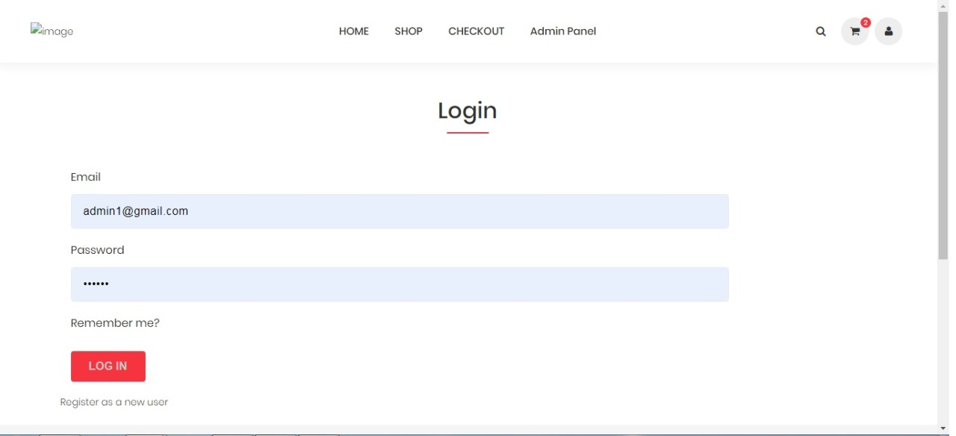
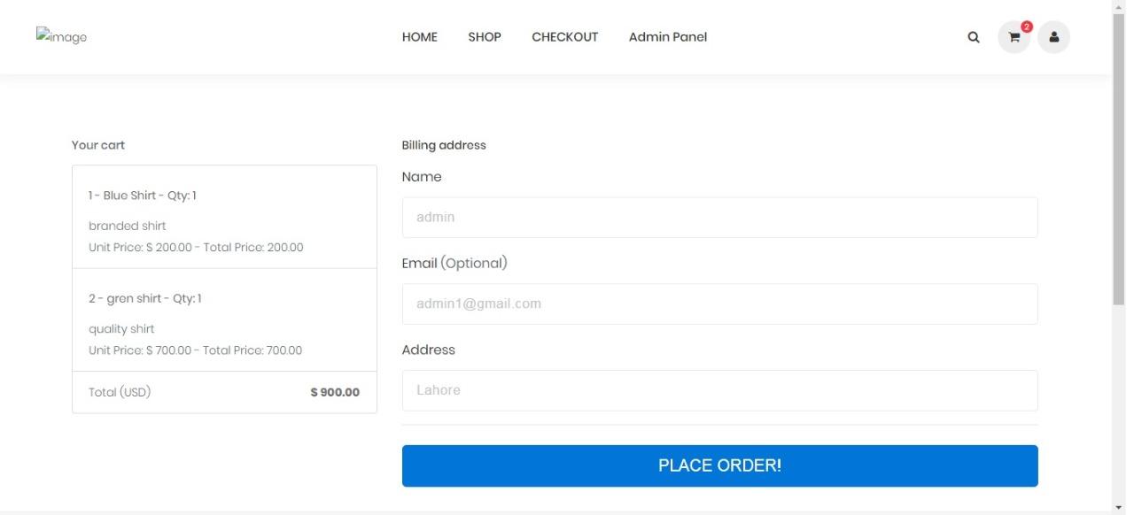
BUYer Panel
Sign up and Login with Verification.
Product details.
Manage cart, Wishlist.
Manage account details (validation)
Store site.
Company store.
Retail /whole dealing.
Advertisement of Companies and stores.
Advertisement of product (video).
Related products.
Review of product with validation.
FAQ’S of product.

Slide 15
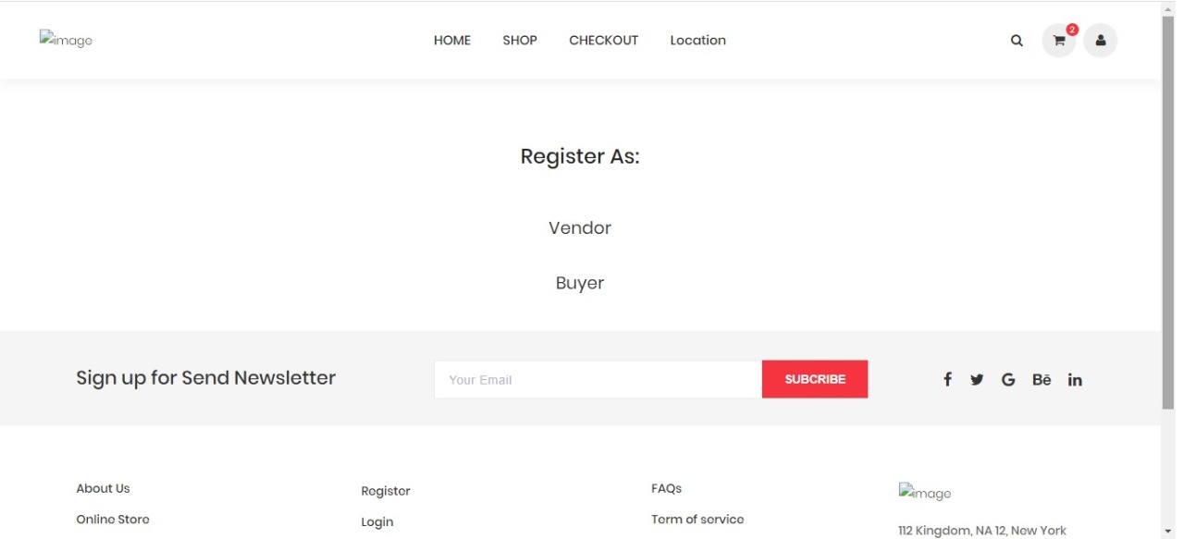
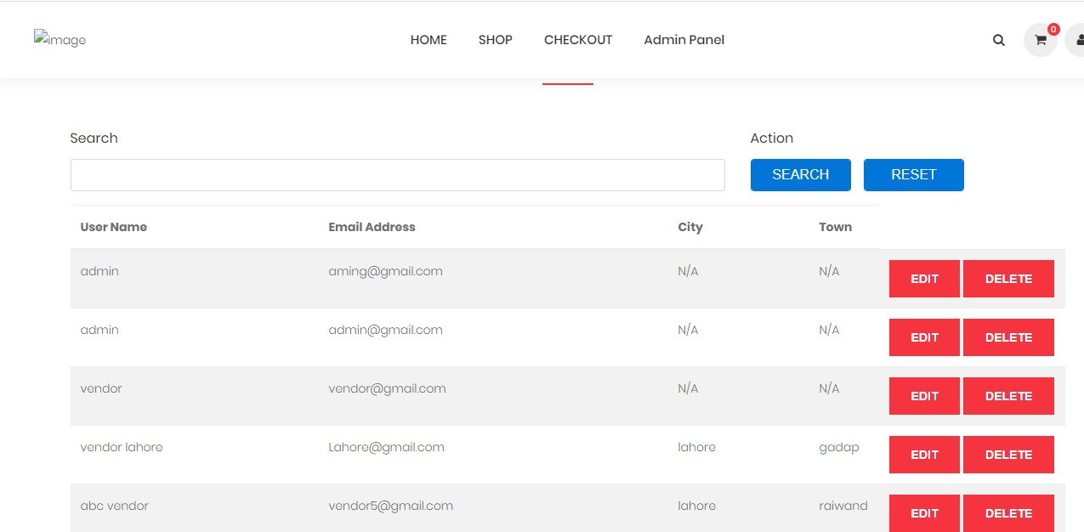
Supplier Panel
Sign up and Login with Verification.
Manage products (SKU, Images, Video).
Manage reviews.
Manage FAQ’s.
Manage categories.
Retail dealing.
Manage coupons.
Manage orders.
Orders invoice.
Store Details.
Store customization (Theme, Colors etc.)

Slide 16
Key Features
Responsive Deign

Slide 17
Development Hurdles
Deploying location part.
Finding the details of the spare parts.
Customization according to requirement.
Dynamic theme customization.

Slide 18
Conclusion
Online shopping is the best way to purchase any item easily but be careful because there may be some fake products on different sites.
Widespread effects on the economy and e-commerce.
With new technology comes better ways of doing things.
Protecting yourself can make shopping online easy and beneficial to all involved.

Slide 19
Task Completed
Admin Panel
Buyer panel
Supplier panel

Slide 20
Remaining Tasks
We have to make the website responsive which works as similar to the pc or laptop.
Will be easy to open the site on the smart phone similar to the size of the pc.

Slide 21
Acknowledgement
We would like to thank:
Sir. Imran Latif (Assistant Professor, COMSATS University Islamabad, Lahore Campus) for his guidance.

Slide 22
JAZAK ALLAH!
Any queries?

